Slide 1

Influenza (Flu)
Getting vaccinated against the flu is more important than ever!

Slide 2
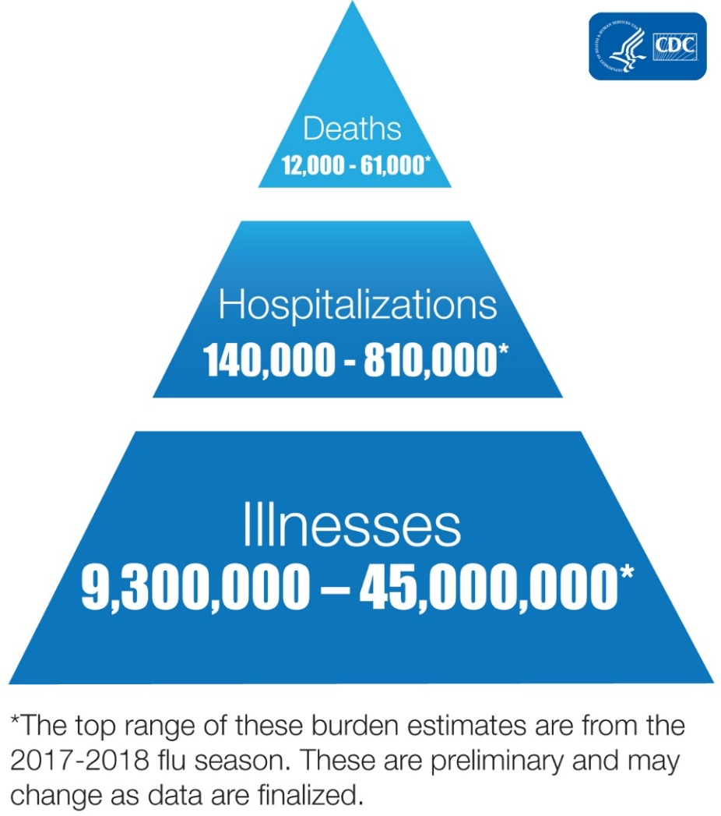
What is the Flu?
The flu is a highly contagious respiratory illness caused by influenza viruses. It can cause mild to severe symptoms and even lead to serious complications, hospitalization, and death.

Slide 3
Flu and COVID-19
Both the flu and COVID-19 are respiratory viruses that can be spread in the air through droplets and through contact with a contaminated surface. They can both cause similar symptoms like:
  Fever
  Cough, runny nose, and/or sore throat
  Shortness of breath
  Tiredness and weakness
  Aches (body, muscle, and headaches)
Fortunately, there are reliable vaccines against both viruses.
  The best way to protect against both types of infections is through vaccination and following prevention measures (masks, hand hygiene)
  Vaccination will also reduce the number of people who will seek out care and testing for possible flu or COVID-19 infections (lower the burden on healthcare system)

Slide 4
The Flu Vaccine
The flu vaccine is still the best way to protect yourself and those you care about against the seasonal flu.
  The CDC recommends everyone 6 months of age and older get it every year.
  It will only protect against this season’s flu, so make sure you also get the COVID-19 vaccine for protection against both types of infections.
Get the flu vaccine through your pharmacy benefit at NO CHARGE.
  Please check with your primary care physician or local pharmacy to see if they offer flu shots.
  Be sure to verify that the pharmacy is a part of your pharmacy network plan.

Slide 5
Everyday Preventive Actions
In addition to getting the flu vaccine, follow these healthy habits to help prevent the flu:
  Cover coughs and sneezes (into a tissue and throw away or into your elbow)
  Frequently wash your hands or use alcohol-based hand sanitizer and avoid touching your mouth, nose, and eyes
  Frequently clean and disinfect surfaces that may be contaminated
  Avoid close contact with anyone who is sick
  Stay home and limit contact with others if you are sick

Slide 6
We Can Fight the Flu Together!
Additional resources on the flu can be found in Ventegra’s Seasonal Flu Resource Center.
REPLACE LINK with location of information on your company intranet site if available.

